Slide 1








Employee Benefits Overview
Plan Year: July 1, 2025 – June 30, 2026
Notes:
Welcome to Meeting Street School’s benefit program overview for the 2025 2026 plan year.

Slide 2
Benefit Highlights & Resources
Meeting Street Schools is proud to offer you and your family a valuable benefits program.
Check out the quick highlights for the 2025-26 plan year.
Benefit Plan Year | The benefit plan year is moving to July 1st.
Medical | Medical will remain with Cigna, with a slight increase in premium.
Spending Accounts | IRS contribution amounts for Health Savings Accounts and Flexible Spending Accounts have increased.
Pet | This benefit is moving to Spot Pet.
Dental Vision Life Disability | There are no changes to carrier or plan designs.
Notes:
Meeting Street Schools is proud to offer you and your family a valuable benefits program.
Check out the quick highlights for the 2025 plan year.

Slide 3

Benefits Eligibility
You are eligible for benefits if you work at least 30 hours per week.
Eligible dependents include:
Your legal spouse
Your children up to age 26
Open Enrollment is now through Friday, June 6th.
Notes:
You are eligible for benefits if you work at least 30 hours per week. Eligible dependents include your legal spouse and your children up to age 26.
Our open enrollment for benefits is held annually and begins May 22nd through May 31st.
Please watch until the end of this presentation to see detailed instructions on how to enroll in your benefits.

Slide 4
Open Enrollment Overview
Review your current benefit elections & verify personal information
Complete your benefit enrollment by Friday, June 6th
Elections made are effective
Tuesday,
July 1st
1
2
3
If you do not make new elections, you will be enrolled & charged for the same benefits you currently have. The ONLY things that do NOT rollover are Dependent Care FSA and Health Care FSA elections. You MUST enroll in those each year if you would like to continue those benefits.
Once you make benefit elections, you will not be able to change them until the next open enrollment period, unless you have a qualified change of status.
Notes:
During Open Enrollment, we recommend reviewing your current benefit elections and the plans available this year.
You will need to complete your enrollment by May 31st. Your elections made will be effective July 1st.
If you do not make new elections, you will be enrolled & charged for the same benefits you currently have. The ONLY things that do NOT rollover are Dependent Care FSA and Health Care FSA elections. You MUST enroll in those each year if you would like to continue those benefits.
Once you make benefit elections, you will not be able to change them until the next open enrollment period, unless you have a qualifying change of status.

Slide 5
Medical & Prescription
Drug Benefits

Slide 6

Medical Plan Overview
Meeting Street Schools offers medical and prescription drug coverage through Cigna.
Access your member account at www.mycigna.com
Set-up your member account to easily manage your plan:
Search for in-network providers
View plan claims
Estimate cost of care
Track progress toward your deductible
Notes:
We offer medical and prescription drug coverage through Cigna. Through your MyCigna.com, you can easily view plan claims, search for in network providers, estimate cost of care, and more.

Slide 7
Helpful Terms
Coinsurance | the percent of a claim that you will pay, after you have met the deductible.
Copay | the amount you pay every time you receive a health service. For instance, if your copay to see a doctor is $25, you pay that amount for each doctor’s visit. Your plan covers the rest.
Deductible | the amount you pay each year before your plan begins paying.
In-network | providers and facilities that are contracted by our plan to offer services to participants at a reduced rate.
Out-of-pocket maximum | maximum dollar amount that you will pay per year before the plan begins paying covered expenses at 100%.
Premium | the amount you pay to receive coverage.
Preventive care | routine health care that includes regular check-ups, patient counseling and screenings to prevent disease, illness and other health complications.
Have you ever had that moment of “what does that even mean”?
Insurance terminology can be confusing – review some of these helpful terms to level up your insurance knowledge!
Notes:
We've included a list of helpful terms related to your medical coverage.

Slide 8

Medical Plan Highlights
 | Medical OAP $500 | Medical OAP HDHP $2,500
Services | In-Network | In-Network
Preventive Services | Covered at 100% | Covered at 100%
Primary Care & Urgent Care | $20 copay | Deductible/Coinsurance
Specialist Visit | $40 copay | Deductible/Coinsurance
Telemedicine (MDLive) | $20 copay | Deductible/Coinsurance
Emergency Room | $150 copay, then coinsurance | Deductible/Coinsurance
Deductible - Benefit Year Individual / Family | $500 / $750 | $2,500 /$5,000
Coinsurance Plan Pays / You Pay | 70% / 30% | 80% / 20%
Out-of-Pocket Max Individual / Family | $2,250 / $4,250 | $5,000 / $10,000
Notes:
Here is an overview of the in-network benefits with our medical plan(s). Preventive care is covered 100% under each plan.
With the Oh Aye Pee Plan, you will pay co-pays for doctor visits and prescriptions. For other services, like a hospital visit, you are responsible for meeting the plan deductible and then the plan pays 80% co-insurance.
With the High Deductible Health Plan, you will pay the negotiated rate for service until you meet the plan deductible. Then, the plan pays 90% co-insurance for future services.
The out of pocket maximum is the most you will pay under each plan during the year.

Slide 9
Prescription Drug Coverage
 | PPO Plan | HDHP Plan
In-Network Benefits | Tiers Generic / Preferred/ Non-Preferred | All Tiers
Retail | $8 / $45 / $70 | 20% after deductible
Mail Order | $20 / $113 / $175 | 20% after deductible
Specialty | $125 | 20% after deductible
Notes:
Here is an overview of your prescription drug benefits with our plan(s).
You can save money on prescriptions by asking your doctor about generic medications or trying the mail order pharmacy.

Slide 10
Know Where To Go
 | Location | Cost | When to Use
 | Primary Care | $ | Routine, primary, preventive care; regular health screenings; non-urgent treatment Chronic disease management
 | Telemedicine | $ | Cold, flu, fever, sore throat, diarrhea, rash, pink eye, sinus infections, cough, headache, stomachache or earache
 | Urgent Care | $$$ | Sprains, small cuts, strains, sore throats, minor infections, mild asthma, back pain or strain, vomiting, flu, fever, sports injuries After hours care & no appointments necessary
 | Emergency Room | $$$$ | Heavy bleeding, large open wounds, chest pain, spinal injuries, difficulty breathing, major burns, severe head injuries, seizures, unconsciousness, poisoning Life Threatening emergency
For less serious issues, skip the ER. Save time
and money by using telemedicine or by visiting your PCP, a retail health clinic or urgent care center.
Notes:
When you get sick or hurt, do you know where to go? Save money by visiting your primary care doctor or using telemedicine for non-urgent issues. Urgent Care provides after hours treatment and walk-up care. If you have a life threatening emergency, the ER is where you should go.

Slide 11

Telemedicine
On-demand telehealth service from Cigna is included with your medical plan!
Board-certified doctors can assist 24/7 with conditions like:
Cold and flu | Allergies
Ear and eye infections | Sore throat
Skin rashes | Insect bites or stings
  Start your appointment at www.MDLIVEforCigna.com or download the MDLiveforCigna app.
Notes:
Telemedicine service from Cigna is included with your medical plan. With telemedicine, you can video chat a doctor anywhere, anytime. These doctors can write prescriptions as needed and diagnose many common sicknesses. Getting started is easy. Simply visit the website or mobile app shown here for more information.

Slide 12
Cigna Resources
Program | Description
Cigna One Guide | Personalized support from Cigna to help you make smarter, informed choices and get the most from our medical plan.
Identity Theft Protection | ID Theft Protection benefit, free of charge, to employees and children under 18 enrolled in a medical plan.
Happify | Self-directed program with science-based games and guided meditations.
iPrevail | Interactive video lessons and one-on-one coaching can help with challenges including post-traumatic stress disorder (PTSD), caregiving, depression, and anxiety.
Employee Assistance Program | Cigna EAP services include up to three in-person consultations, referrals, and resources and can assist with issues such as depression, grief and loss, martial and family concerns, legal guidance and more.
Those enrolled in a Cigna medical plan have access to additional resources!
Log into your myCigna account to get started using these resources.
Notes:
Those enrolled in a Cigna medical plan have access to additional resources including Cigna One Guide, identity theft protection, Happify, Iprevail and an additional Employee Assistance program. Get started through your myCigna account today!

Slide 13
Your Cost for Medical Coverage
Meeting Street Schools shares the cost of your medical coverage.
Your cost for coverage is deducted pre-tax from your biweekly paycheck.
Employee Per Biweekly Pay Period Premium
 | Employee Only | Employee & Spouse | Employee & Children | Employee & Family
Copay Plan | $60.51 | $197.33 | $121.03 | $263.10
HDHP Plan | $42.34 | $127.01 | $70.56 | $177.82
Notes:
Here is your cost for medical coverage this year. Your premium is deducted pre-tax from your paycheck.

Slide 14
Other Well-being Benefits

Slide 15

Wellness Offerings
Meeting Street Schools is committed to being your partner in health!
Headspace Care – Mental Health Support
  Free, 24/7 access to behavioral health coaching via text-based chat and video-based therapy
  With Headspace, you can get support for stress, loneliness, sleep, grief, anxiety, depressed mood and mood disorders, relationship and interpersonal issues, substance use, and more
  Confidential – MSS will not receive any information about your use of the benefit
  Download the Headspace Care (Ginger) app from the Apple App Store or
  Google Play to start using your confidential mental health wellness benefit!
Notes:
Meeting Street Schools is committed to being your partner in health!
We offer Headspace Care for mental health support that includes free 24/7 access to behavioral health coaching via text-based chat and video-based therapy. With Headspace, you can get support for stress, loneliness, sleep, grief, anxiety, depressed mood and mood disorders, relationship and interpersonal issues, substance use, and more. Download the Headspace care slash Ginger app from the Apple App Store or Google Play to start using your confidential mental health wellness benefit.

Slide 16
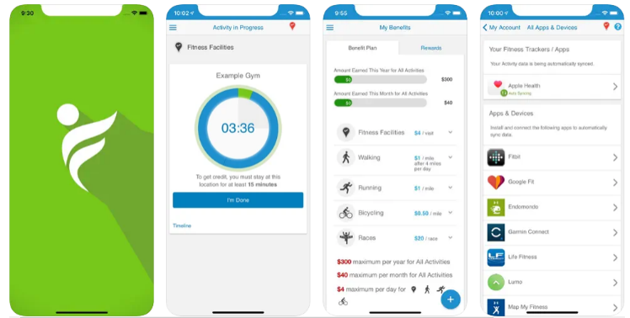
Wellness Offerings
Incentfit – Physical Wellness
Earn up to $300 per year in rewards for exercising and living a healthy lifestyle
You can earn rewards by attending fitness facilities, participating in races, and getting daily exercise
You can also receive reimbursements for healthy purchases such as gym memberships and fitness equipment!
To learn more, visit https://webapp.incentfit.com/login
Notes:
You are also offered a physical wellness benefit called In cent Fit. You can earn up to $300 per year in rewards for exercising and living a healthy lifestyle. Earn rewards by attending fitness facilities, participating in races, and getting daily exercise and you can also receive reimbursements for healthy purchases such as gym memberships and fitness equipment!
To learn more, visit the website shown here.

Slide 17

Wellness Offerings
Modern Minds – Mental Wellbeing Benefit
All of Modern Minds wellness-focused therapy programs are covered under this new beneﬁt.
You can schedule a consultation to explore ﬂexible wellness-focused therapy programs, which
can include medication and nutrition guidance. You can also receive reimbursements for healthy purchases such as gym memberships and fitness equipment!
To learn more, visit modern-minds.com/lets-talk/ or call 843-531-9036 to book
your appointment.
Notes:
You are also offered a physical wellness benefit called In cent Fit. You can earn up to $300 per year in rewards for exercising and living a healthy lifestyle. Earn rewards by attending fitness facilities, participating in races, and getting daily exercise and you can also receive reimbursements for healthy purchases such as gym memberships and fitness equipment!
To learn more, visit the website shown here.

Slide 18

Tax-Advantaged
Accounts

Slide 19
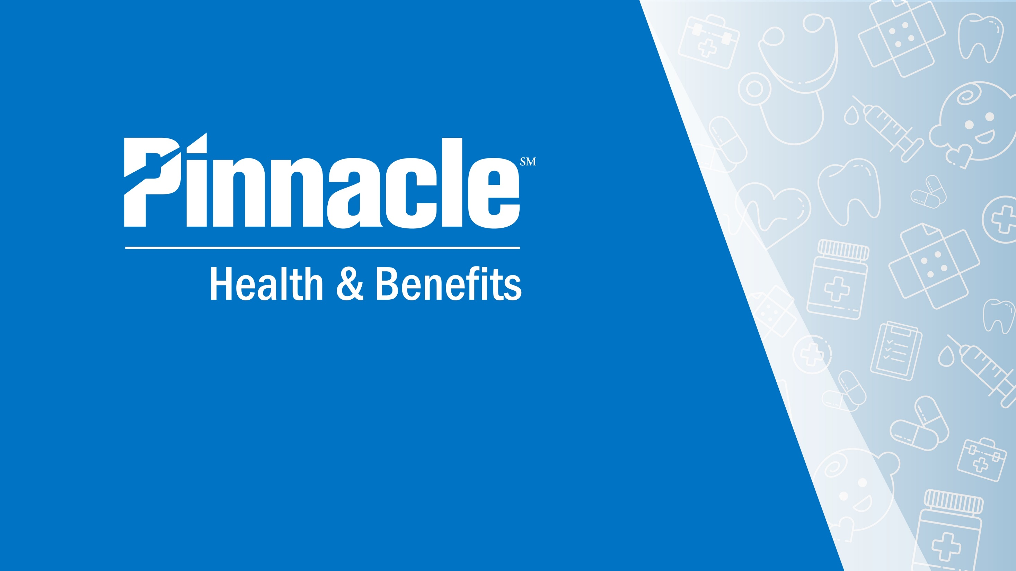

Slide 20
Accounts Offered
Health FSA (pairs with medical copay plans)
Account Flexibility Use it or lose it Contribution changes only for life events
Tax Advantage Contributions – Payroll Pretax Qualified Expenses – Tax Free Disbursements
2025 Contribution Limits $3,300 Your full election is available July 1, 2025
End of Plan Year 2 ½ Month Grace Period 90 Day Run Out
Notes:
See a summary of the tax advantaged accounts available to you. Details for each account are shown here.

Slide 21
Accounts Offered
HSA (Must be enrolled in HDHP Plan)
Account Flexibility Follows account holder & accumulates annually Can change contribution amount
Triple Tax Advantage Contributions – Payroll Pretax Tax Free Growth Qualified Expenses – Tax Free Disbursements
2025 Contribution Limits $4,300 Individual $8,550 Family (At age 55+ eligible for $1,000 catchup contribution)
Invest Excess Funds Investment Minimum - $2000
Employer Contribution Into YOUR HSA
Employee Only Coverage on HDHP: $800 $400 in July 2025 $400 in January 2026
Family Coverage on HDHP: $1,600 $800 in July 2025 $800 in January 2026
Notes:
See a summary of the tax advantaged accounts available to you. Details for each account are shown here.

Slide 22
Accounts Offered
Dependent Care
Account Flexibility Use it or lose it Contribution changes only for life events
Tax Advantage Contributions – Payroll Pretax Qualified Expenses – Tax Free Disbursements
2025 Contribution Limits $5,000 ($2,500 if married and filing separately)* Funds are available based on payroll deduction
End of Plan Year 2 ½ Month Grace Period 90 Day Run Out
Notes:
See a summary of the tax advantaged accounts available to you. Details for each account are shown here.

Slide 23
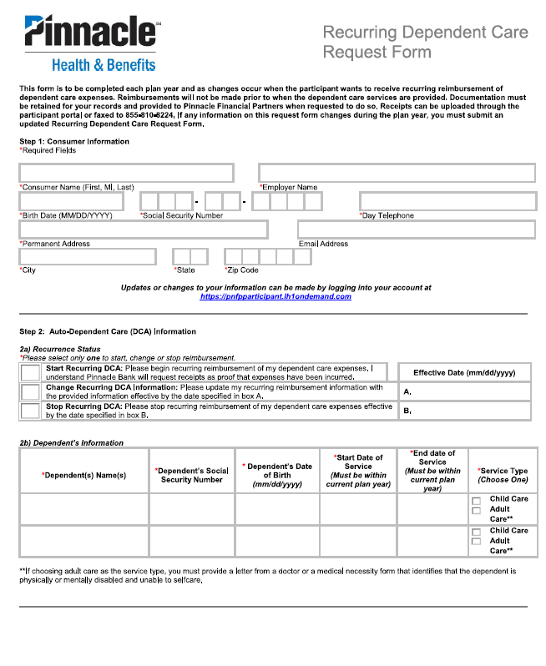
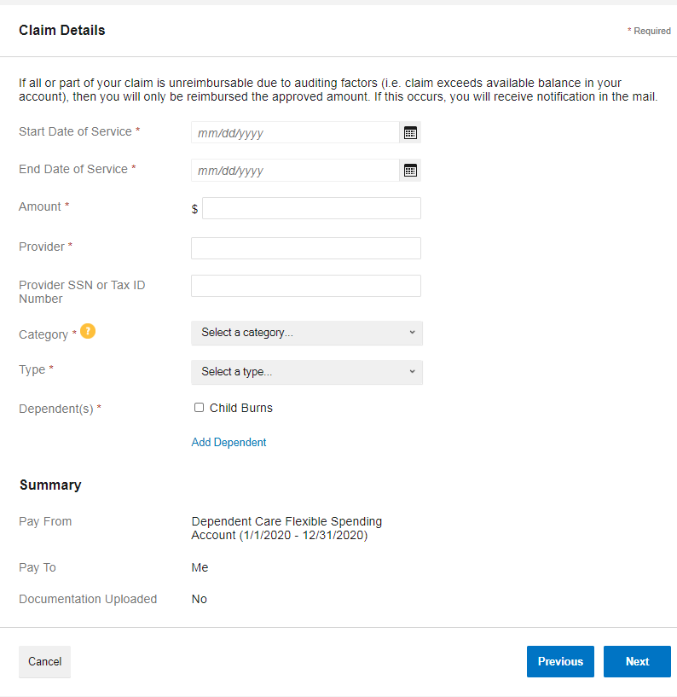
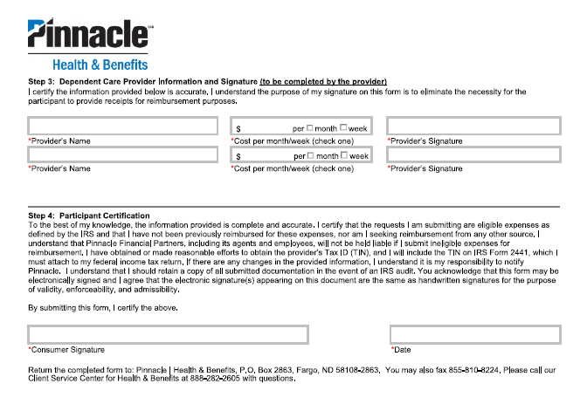
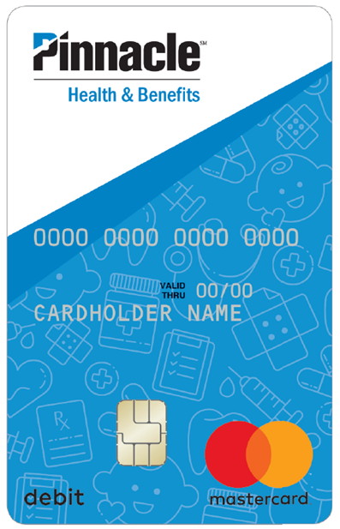
Dependent Care FSA Pro Tips
3 ways to access your funds
Recurring Reimbursement Form
Complete this one time each plan year and get reimbursed for expenses each time you get paid.
File a claim online or in the mobile app
Debit Card
This account is for eligible child and adult care expenses. This includes preschool, nursery school, day care, before and after school care and summer day camp. It's the care your family needs, while you're at work.
Notes:
This dependent care FSA account is for eligible child and adult care expenses. This includes preschool, nursery school, day care, before and after school care and summer day camp. It's the care your family needs, while you're at work.
Accessing your dependent care FSA is easy through the various ways shown here.

Slide 24
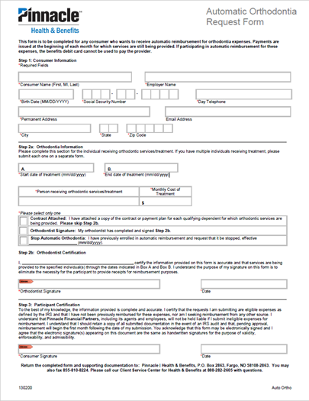

FSA Pro Tips
Use worksheet to estimate your spend- Use it or lose it
Be a pro at substantiation – Explanation of Benefits are excellent receipts
What information does the IRS require on a receipt?
    Patient’s name
    Provider’s information (doctor name, hospital, pharmacy, etc.)
    Date of service
    Description of service or item purchased
    Your out-of-pocket cost
Know what expenses are qualified
Keep track of your balance
Any unused funds at the end of year? Try shopping the FSAstore.com
Automatic Orthodontia Request Form
Complete this one time each plan year and get reimbursed for monthly expenses at the 1st of every month.
Notes:
Here are some FSA pro tips….
Use worksheet to estimate your spend- Use it or lose it…..
Be a pro at substantiation – Explanation of Benefits are excellent receipts….
Know what expenses are qualified…..
Keep track of your balance …
Any unused funds at the end of year? Try shopping the FSAstore.com…

Slide 25
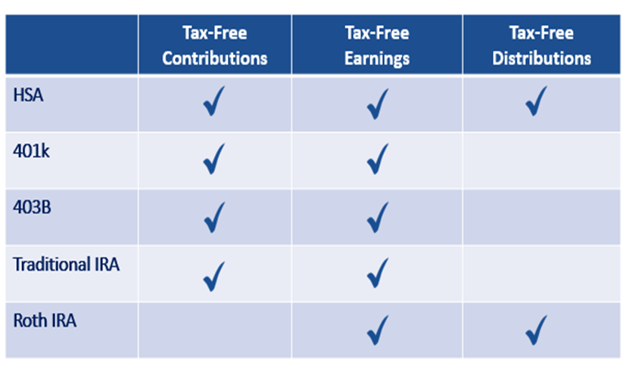
HSA Pro Tips
Take advantage of this Triple Tax Advantaged Account
At age 65, the 20% penalty for non qualified expenses drops off and you just pay ordinary income tax on non-qualified expenses
You can use HSA funds to pay for Medicare Part B premiums when you turn 65.
There’s no expiration date on reimbursing yourself
Let the balance grow, earn interest, invest
Funds are to be used for you, your spouse & tax dependents
Save or upload all receipts to the online portal
You have access to your HSA via computer, mobile app, & debit card.
An HSA can transfer to a spouse if you pass. If no spouse, funds will be disbursed to your beneficiary or estate.
Notes:
Here are some HSA Pro tips. Take advantage of this Triple Tax Advantaged Account
At age 65, the 20% penalty for non qualified expenses drops off and you just pay ordinary income tax on non-qualified expenses
You can use HSA funds to pay for Medicare Part B premiums when you turn 65.
There’s no expiration date on reimbursing yourself
Let the balance grow, earn interest, invest
Funds are to be used for you, your spouse & tax dependents
Save or upload all receipts to the online portal
You have access to your HSA via computer, mobile app, & debit card.
An HSA can transfer to a spouse if you pass. If no spouse, funds will be disbursed to your beneficiary or estate.

Slide 26
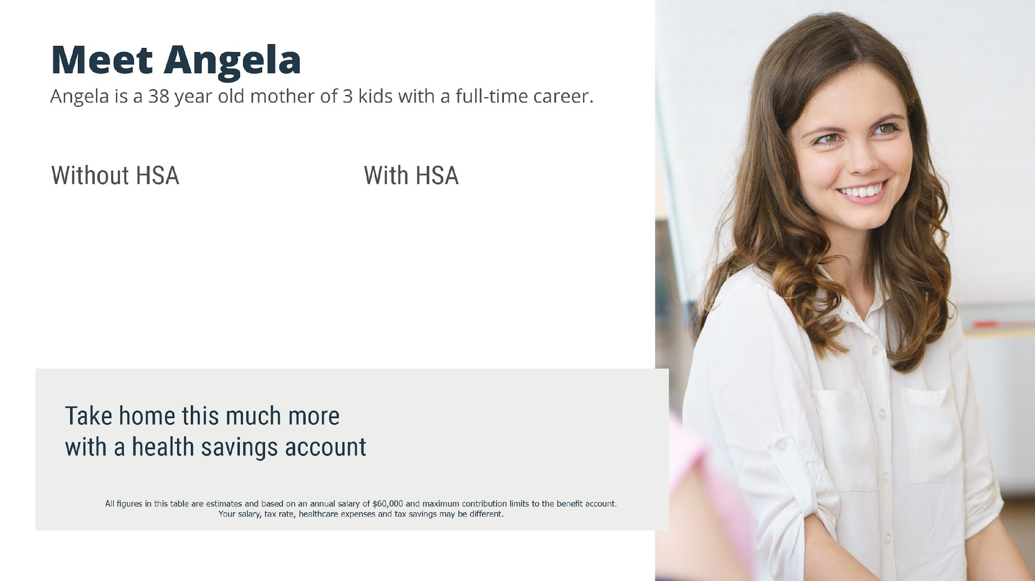
GROSS ANNUAL PAY………… $60,000
TAX RATE (18%) ………..…… -$10,800
NET ANNUAL PAY ………..… $49,200
HEALTHCARE EXPENSES …… -$6,750
FINAL TAKE-HOME PAY ……. $42,250
GROSS ANNUAL PAY…………… $60,000
ANNUAL HSA CONTRIBUTION -$6,750
ADJUSTED GROSS PAY …….…..$53,250
TAX RATE (18%) ………..……..… -$9.585
FINAL TAKE-HOME PAY …...…. $43,665
$1,215
Notes:
See an example of how an HSA works in real life here.

Slide 27


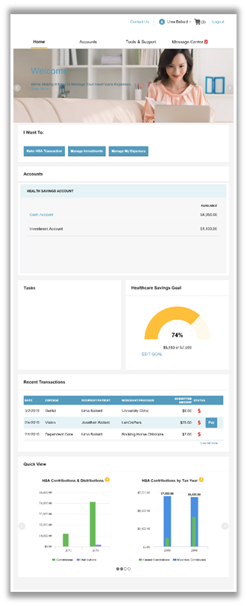

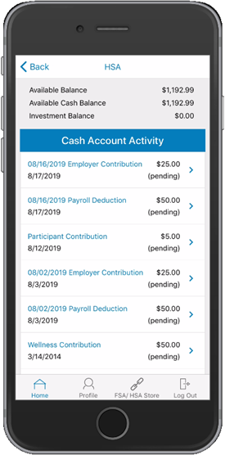
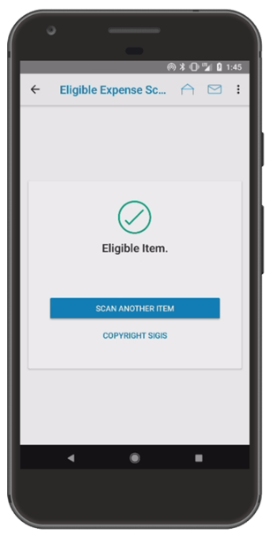
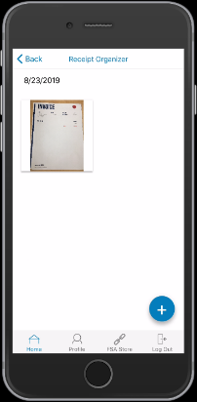
Anytime, Anywhere Access
Online
Track expenses
Includes dashboard for viewing and budgeting expense
Link a bank account to receive reimbursements
Make payments directly to providers as a one-time expense or recurring expense (i.e. orthodontist)
Mobile App
Debit Card
Vertical and versatile!
Use directly at providers and merchants or for balance due invoices
Additional cards available at no cost for spouse or dependents over the age of 18
Can only be used at merchants or providers who offer qualified medical expenses or services. Will decline at gas stations, tire stores, etc.
iPhone or Android
Search app store for Pinnacle Health and Benefits
View transactions and access account details
Upload receipts using phone’s camera
Set text message alerts
Scan bar codes for eligibility
Notes:
Pinnacle offers multiple ways to keep track and manage your accounts through an online portal, mobile app or debit card.

Slide 28

Dental
Benefits

Slide 29


Dental Insurance from Guardian can help protect your health
Quality Care, Choice, and Cost Savings
Provides access to one of the nation’s largest dental networks
Can save you money if you use a Guardian
in-network dentist
Helps protect your health with quality preventive care
Helps pay for more extensive and often unexpected expenses such as fillings, crowns, and root canals
Notes:
Dental Insurance from Guardian can help protect your health. Guardian’s dental insurance Provides access to one of the nation’s largest dental networks, Can save you money if you use an in-network dentist, Helps protect your health with quality preventive care and Helps pay for more extensive and often unexpected expenses such as fillings, crowns, and root canals

Slide 30
Your Guardian Dental PPO Plan Options
DentalGuard Preferred Network | Option 1: Low Plan |  | Option 2: High Plan
Calendar Year Deductible | In-Network | Out-of-Network | In-Network | Out-of-Network
Individual Family Limit Waived for | $50 3 per family Preventive |  | $50 3 per family Preventive
Co-Insurance Preventive Care (e.g., cleanings) Basic Care (e.g., fillings) Major Care (e.g., crowns, dentures) Orthodontia | 100% 100% 60% 50% | 90% 70% 40% 50% | 100% 100% 60% 50% | 90% 70% 40% 50%
Annual Maximum Benefit | $1,000 |  | $2,000
Lifetime Orthodontia Maximum (Children) | $500 |  | $2,000
Dependent Age (Non-Student/Student) | To age 26 |  | To age 26
Notes:
Here is an overview of your Guardian dental plan options.

Slide 31
Get the ‘Maximum’ from Your Dental Benefits
Here is an example of how the Maximum Rollover feature works¹
    Guardian rolls over a portion of your unused annual maximum into your Maximum Rollover Account (MRA)
    To qualify you must have one visit with a paid claim and must not have exceeded the paid claims threshold
    Your MRA may not exceed the MRA limit.
Plan Annual Maximum² | Threshold | Maximum Rollover Amount | In-Network Only Rollover Amount | Maximum Rollover Account Limit
$1,000 | $500 | $250 | $350 | $1,000
$2,000 | $800 | $400 | $600 | $1,500
Maximum Claims Reimbursements | Claims amount that determines rollover eligibility | Additional dollars added to Plan Annual Maximum for future years | Additional dollars added to Plan Annual Maximum for future years if only In-Network providers were used during the benefit year | Plan Annual Maximum plus Maximum Rollover cannot exceed $2,000 ( Low Plan ), $3,500 (High Plan) in total
Low Plan
High Plan
Year 1
Year 3
Year 2
Year 4
1 For illustrative purposed only. Covered benefits and benefit amounts may vary by employer-sponsored plan. See your plan for specific coverage amounts. 2 If a plan has a different annual maximum for PPO benefits vs non-PPO benefits, ($1500 PPO/$1,000 non-PPO for example) the non-PPO maximum determines the Maximum Rollover plan.
Notes:
Here is an example of how the maximum rollover feature works from your dental benefits.

Slide 32

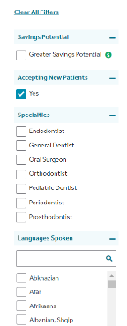
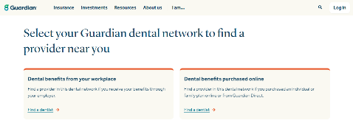
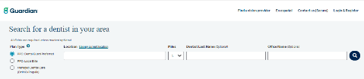
How to Find a Dental Provider
1
4
Smile. Finding a dentist in the Guardian network is easy.
    Go to guardianlife.com and click “Find a dentist”
    Under “Dental benefits from your workplace” click “Find a dentist”
    Search for a dentist in your area
      Select the Plan Type
      Enter your search parameters
    Customize your search by distance, specialty, and language spoken
2
3
Away from your computer? No problem.
Download the GUARDIAN® Providers & ID Card app to your mobile phone or tablet and find a dentist on the go. Visit guardianlife.com to download the app.
Notes:
Easily find an in network dentist through the instructions here.

Slide 33
Your Cost for Dental Coverage
Meeting Street Schools shares the cost of your dental coverage.
Your cost for coverage is deducted pre-tax from your biweekly paycheck.
Employee Per Pay Period Premium
 | Employee Only | Employee & Spouse | Employee & Children | Employee & Family
Base Plan | $0.00 | $15.42 | $12.62 | $28.02
Buy-Up Plan | $3.02 | $21.42 | $26.52 | $46.21
Notes:
Here is your cost for dental coverage this year. Your premium is deducted pre-tax from your paycheck.

Slide 34

Vision
Benefits

Slide 35

Why do you need Vision insurance?
Keep an eye on your vision health and savings
Regular vision exams can detect major medical problems, such as¹:
    Glaucoma
    Diabetes
    High blood pressure
    Increased stroke risk
Pays for services and eyesight correction that medical insurance plans don’t typically cover
Covers preventive care like routine eye wellness exams and retinal screenings
Provides discounts on new eyeglasses, contact lenses, and corrective surgery like Lasik
¹ American Academy of Ophthalmology, 20 Surprising Health Problems an Eye Exam Can Catch, https://www.aao.org/eye-health/tips-prevention/surprising-health-conditions-eye-exam-detects, 2020.
Notes:
Keep an eye on your vision health and savings. Regular vision exams can detect major medical problems, Pays for services and eyesight correction that medical insurance plans don’t typically cover, Covers preventive care like routine eye wellness exams and retinal screenings and Provides discounts on new eyeglasses, contact lenses, and corrective surgery like Lasik.

Slide 36
Your Guardian Vision Plan - Davis Network
Covered Services: | In-Network (You pay) | Out-of-Network (You pay)
Office Visit Copay | $20 | You pay based on a schedule – see your kit for details
Materials Copay | $20 | You pay based on a schedule – see your kit for details
Frames | 80% of amount over $120 | Amount over $48
Elective Contact Lenses (In lieu of frames and lenses) | 85% of amount over $120 | Amount over $105
Contact Lenses (Medically Necessary* with prior approval) | $0 | Amount over $210
Laser Correction Surgery Discount | Savings of 20-35% off national average price thru Davis laser vision network | Not applicable
Service Frequencies:
Exams | Every calendar year | Every calendar year
Lenses | Every calendar year | Every calendar year
Frames | Every two calendar years | Every two calendar years
Notes:
Here is an overview of your guardian vision plan option in the davis network.

Slide 37
Your Cost for Vision Coverage
Meeting Street Schools shares the cost of your vision coverage.
Your cost for coverage is deducted pre-tax from your biweekly paycheck.
Employee Per Pay Period Premium
 | Employee Only | Employee & Spouse | Employee & Children | Employee & Family
Vision Plan | $0.00 | $1.02 | $0.72 | $1.39
Notes:
Here is your cost for vision coverage this year. Your premium is deducted pre-tax from your paycheck.

Slide 38

How to use your Guardian vision and dental benefits
No ID Cards needed
Simply provide your Group ID number at your first office visit: 501207
Or, access your ID card online.
Mobile App: Download Guardian’s Provider and ID Card app to your phone or tablet.
Online: Go to guardianlife.com and select “Log in.” From the homepage you can access your ID card.
Notes:
You can use your Guardian vision and dental benefits online via the website or mobile app.

Slide 39

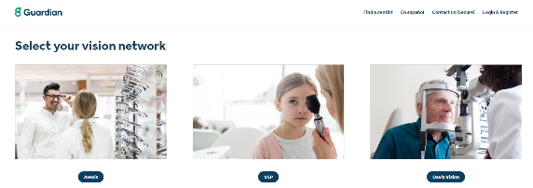
How to Find a Vision Provider
2
Finding a vision provider in the Guardian network is easy
1
    Go to guardianlife.com
    Click “ Find a vision provider”
    Select your vision network
      Enter your search parameters
      Follow the directions for a list of vision
      providers convenient to you
3
Away from your computer?
No problem.
Download the Guardian Provider app for your phone or tablet and find a vision provider on the go. Visit guardianlife.com to download the app.
Notes:
Easily find an in network vision provider through the instructions here.

Slide 40

Life & Disability
Benefits

Slide 41

Why do you need
Life Insurance?
Smart, affordable protection for you and your family
  Provides a benefit to help pay expenses and provide financial protection for those who depend on you.
  Can cover things like mortgage, legal, medical fees, childcare, education, and outstanding debts.
  Three unique benefits only life insurance provides:
      - Paid directly to your beneficiaries
      - Generally, not subject to income taxes*
      - The value is not affected by market conditions
  Flexible coverage that you can update as your life changes.
*Life insurance death benefit is generally not subject to income taxes.
Notes:
Life insurance Provides a benefit to help pay expenses and provide financial protection for those who depend on you.

Slide 42
How much Life Insurance protection do you need?
Guardian makes it easy!
Simplified enrollment and affordable group coverage
Convenient payroll deduction
Available for spouse and children
Take the coverage with you
if you leave your current employer
A general guideline is to have a policy equal to seven to ten times your annual salary*:
=
X
7-10 Years
Annual Salary
Policy Amount
*This is Guardian's Rule of Thumb based on experience and may not apply universally to every individual and their unique set of circumstances.
Notes:
Here’s a guideline of how much life insurance protection you need.

Slide 43
Your Life Insurance options
 | Basic Life | Voluntary Term Life
Employee Benefit | 100% of annual salary to a max of $300,000 | $10,000 increments to a max of $350,000
Spouse Benefit | N/A | $5,000 increments to a max of $250,000
Child(ren) benefit To age 26 | N/A | $10,000
Accidental Death and Dismemberment | Included | N/A
Guarantee Issue* You are not required to answer health questions to qualify for coverage up to and including the specified amount, when you sign up for coverage during the initial enrollment period. | Up to $150,000 | Employee Less than age 69, $50,000, 70+, $10,000. Spouse Less than age 65, $25,000, 65-70, $10,000, 70+, $0 Dependent children $10,000.
Age reduction Benefits are reduced by a certain percentage as you age | 50% at age 70 | 50% at age 70
*To apply for life insurance coverage above this amount, or if you have been previously declined for coverage, a brief application and a few health questions will be required.
Notes:
Here is an overview of your life insurance options through Guardian.

Slide 44

Electronic Evidence of Insurability (EOI)
Easy-to-use online form
Simple steps to provide your additional health information:
You will receive an email or letter from your employer or Guardian with a link to submit your EOI form online
Follow the unique link
Create a Guardian Anytime account
Click the EOI form
Answer all the questions on the form and then Submit
Applicable to coverage requiring full Evidence of Insurability (not applicable to conditional issue amounts). Electronic EOI is not available in the following states: New York and New Hampshire. Electronic EOI is available using most internet browsers.
Notes:
You can submit an electronic evidence of insurability by following the instructions shown here.

Slide 45

What is Disability Insurance?
Help protect your paycheck if you are unable to work
  Replaces a portion of your income if you’re diagnosed with a serious illness or experience an injury that prevents you from doing your job.
    Easy enrollment through your workplace
    Affordable group rates
    Timely and efficient claims review and payment
    Extensive resources and support to help you get back to work and living a productive life
Notes:
Disability insurance Replaces a portion of your income if you’re diagnosed with a serious illness or experience an injury that prevents you from doing your job.

Slide 46
Your Disability Insurance options
 | Employer Paid Short Term Disability | Employer Paid Long Term Disability
Coverage Amount | 60% of salary to a maximum $1,500/week | 66.7% of salary to a maximum $7,500/month
Maximum Payment Period | 12 weeks | Social Security retirement age
Accident Benefits Begin | Day 8 | Day 91
Illness Benefits Begin | Day 8 | Day 91
Pre-existing conditions | N/A | 3 months look back; 12 months after exclusion
Notes:
Here is an overview of your disability insurance options.

Slide 47
Supplemental
Health Benefits

Slide 48

What is Critical Illness Insurance?
Financial protection to help you cope
  Get paid a lump sum benefit payment if you suffer a serious illness, such as a heart attack, stroke, or cancer.
  It pays you in addition to your medical insurance, no matter what type of plan you have.
  The benefits are paid directly to you, and you decide how to use them.
  It’s an affordable way to supplement and pay for the additional expenses your health insurance doesn’t cover.
Notes:
Critical illness insurance pays a lump sum benefit payment if you suffer a serious illness such as a heart attack, stroke or cancer and pays you in additional to your medical insurance, no matter what type of plan you have. The benefits are paid directly to you and you can decide how to use them.

Slide 49
Your Critical Illness Plan
 | Employee | Dependents
Benefit Amount | $10,000 increments to a max of $20,000 | Spouse¹ $5,000 increments to a max of $10,000 (not to exceed 50% of employee amount) Child² 25% of employee amount
Portability | Included
Pre-existing Conditions Any condition for which you, in the specified time period prior to coverage in this plan, consulted with a physician, received treatment, or took prescribed drugs | N/A
Health Screening | Annual payment of $50 per insured individual when you and/or your covered dependents² complete certain routine wellness procedures or screenings
Guaranteed issue Health questions are required if the elected amount exceeds the guaranteed issued amount | Employee: $20,000 Spouse: $10,000 Child: All amounts
Dependent age² | Childbirth to 26 years
¹In Washington, a Spouse includes a state-registered domestic partner.
²In Washington, coverage may be continued for disabled children age 26 and older per the terms of the Certificate of Coverage.
Notes:
See details of your critical illness plan offering here.

Slide 50
Your Critical Illness Plan
Conditions | 1ST Occurrence | 2ND Occurrence
Invasive Cancer | 100% | 100%
Carcinoma In Situ | 30% | Not covered
Skin Cancer | $250 per lifetime | Not covered
Heart Attack | 100% | 50%
Stroke | 100% | 50%
Heart Failure | 100% | 50%
Coronary Arteriosclerosis | 30% | Not covered
Kidney Failure | 100% | 50%
Organ Failure | 100% | 50%
First occurrence benefits also available for conditions such as neurological, injuries, and quality of life benefits and/or childhood covered conditions. See plan documents for more details.
Notes:
See list of covered conditions here.

Slide 51

What is Accident Insurance?
Note: Bracketed text is optional - remove if not included in the plan
Accidents can happen to anyone at anytime
    It’s an extra layer of protection that pays you when you suffer an unexpected, qualifying accident.
    Supplements your medical plan — no matter what other insurance
    you have
    Benefit payment paid directly to you, based on covered injuries, treatments
    and services
    Use the money for any purpose, whether for medical or non-medical expenses
    Extra protection for child athletes — 25% increase in your benefit if a covered dependent child is injured while playing an organized sport — must be 18 years or younger
    Start each year with $300 in your Rainy Day Fund and, if you don’t use any of it, a part of it keeps rolling over to the next year.¹
1. The Rainy Day Fund does not apply to benefits without frequency limitation or Wellness claims. See plan documents for covered benefits. 2.Automatic Increase Benefit - covered person must be insured under the certificate for 12 consecutive months before the first adjustment is apply. Increase is for the first 5 years of coverage. Does not apply to disability, hospital confinement due to sickness, and wellness benefit.
Notes:
Accident insurance pays you when you suffer an unexpected, qualifying event. Benefits are paid directly to you, based on covered injuries, treatments and services. Use the money for any purpose, whether for medical or non-medical expenses.

Slide 52
Your Accident Insurance Plan
Benefit | Coverage details
Accident Coverage Type | Off Job
Accidental Death and Dismemberment (AD&D) | Employee $10,000; Spouse¹ $5,000; Child² $5,000
Payment Features | Based on a schedule (see your employee kit)
Child Organized Sports Benefit (must be 18 years or younger) | 25% increase to child benefits
Rainy Day Fund | $300 per year
Wellness Benefit | Annual payment of $50 per insured individual when you and/or your covered dependents² complete certain routine wellness procedures or screening
Portability | Included
Dependent Age² | Childbirth to 26 years
¹In Washington, a Spouse includes a state-registered domestic partner.
²In Washington, coverage may be continued for disabled children age 26 and older per the terms of the Certificate of Coverage.
Notes:
View details about your accident insurance offering here.

Slide 53

Wellness Benefit
Get money back for taking care of yourself
    Receive a $50 benefit payment once a year when you or a covered individual completes a routine wellness screening such as*:
    Mammogram
    Colonoscopy
    Chest x-ray
    Fasting blood glucose test
    PSA blood test
    And more…
    For a complete list of covered wellness screenings go to Guardian Anytime.
*One Wellness Benefit per calendar year per covered person if a covered person has a wellness test or procedure performed while coverage is in force. See your plan details for benefit amounts.
Notes:
Receive a $50 benefit payment once a year when you or a covered individual completes a routine wellness screening such as Mammogram, Colonoscopy, Chest x-ray, Fasting blood glucose test, PSA blood test, And more…
For a complete list of covered wellness screenings, visit Guardian Anytime.

Slide 54
Additional
Benefits

Slide 55



Employee Assistance Program (EAP)
Your employee assistance program, provided by Uprise Health, gives you access to online and coach-guided resources for resilience, stress, and mental fitness.
Health
Healthy living
Stress management
Mental health
Diet and fitness
Overall wellness
Family
Parenting support
Child and elder care
Learning programs
Special needs help
Legal and Financial
Legal issues
Will preparation
Taxes and debt
ID Theft services
Financial tools and assistance
Medical bill negotiation tools
Notes:
Meeting Street Schools offers an Employee Assistance Program through Guardian. Our EAP is available to all employees and their families.
The EAP can help you resolve personal issues and problems before they affect your health, relationships and work performance including: stress, substance abuse, financial issues, and much more.

Slide 56
Employee Assistance Program (EAP)
Provides guidance on personal, financial, and legal matters – plus helpful workplace tools
Program Highlights
Face-to-Face Counseling – up to 3 in-person or virtual sessions per employee/
household member per issue, per year.
Online Coaching – learn, develop, and practice new skills to improve mental fitness. Includes a well-being check, online modules selected specifically for you, and up to 3 coaching sessions.
Work-Life Services – resources to help balance all your responsibilities with family, caregiving, health and wellness, emotional well-being, and daily living.
Legal Services – unlimited telephonic support and free initial 30-minute attorney consultation (can be used for estate planning/will preparation), 25% discount on attorney services thereafter, online self-service legal documents, and extensive law library.
Financial Services – unlimited telephonic support for financial problems or needs, 30 days access with a personal money coach, extensive online financial library and calculators.
Notes:
EAP’s can provide guidance on personal, financial and legal matters.

Slide 57
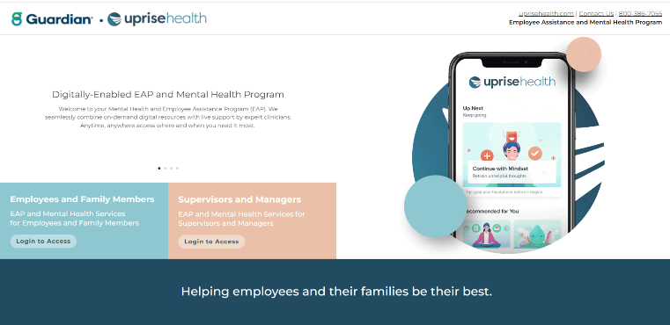
Connect to an EAP counselor for free support services
Support and guidance how and when you need it
Employee Assistance Program
Phone: 1-800-386-7055
Available 24 hours a day, 7 days a week*
Web: worklife.uprisehealth.com
Access code: worklife
*Regular office hours: Monday-Friday 9am-8pm EST.
Notes:
Contact the EAP 24/7 online or by calling the number shown here. Get the support and guidance how and when you need it.

Slide 58


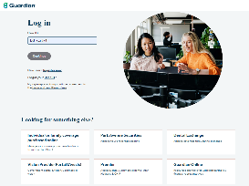
How to register for and access your benefits on Guardian Anytime
Services available to you on Guardian Anytime
Find a provider and estimate costs
Check claim status and receive emails when claims are paid
View, download and print materials:
Benefit summaries
Forms
Certificate booklets
Member ID cards
Provider directories
For assistance, contact Guardian’s Customer Response Unit
Helpline (800) 627-4200
Monday - Friday, 8:00am – 8:00 pm EST
Refer to your plan number: 501207
Go to guardianlife.com and click on “Log in”
Choose “Register now” and select “Guardian Anytime”
Select “employee” for yourself or “child, spouse or partner” for your dependents
Complete the self registration process, click Submit, and you’re done.
Notes:
Through your Guardian anytime account, you can easily find a provider and get cost estimates, check claims status, view benefit summaries, view ID Cards and more. Follow the instructions here to register.

Slide 59


Employee Discount Program
Discounts and perks are fun!
With BenefitHub, enjoy discounts, rewards, and perks on thousands of the brands you love in a variety of categories:
Getting started is easy!
Access your discounts at https://meetingstreetschools.benefithub.com and create an account using referral code: GT4A5E
Travel | Entertainment
Auto | Restaurants
Electronics | Health and Wellness
Apparel | Beauty and Spa
Local Deals | Tickets
Education | Sports and Outdoors
Notes:
Meeting Street Schools is pleased to bring you access to BenefitHub. Enjoy discounts, rewards, and perks on thousands of the brands you love. Categories include travel, beauty, tickets and more.

Slide 60

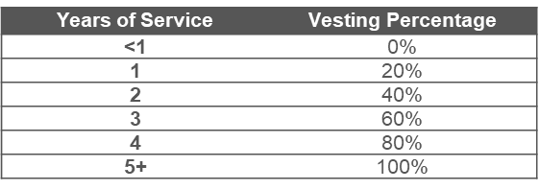
Retirement Savings Plan
Meeting Street Schools offers a 403(b) retirement plan through Empower.
Save for a financially secure future!
Contribute up to $23,000 per year ($30,500 if you’re age 50 or older)
Company will match the following amounts:
  50% of the first 6% of your eligible compensation
You are 100% vested in all of the funds you choose to contribute as well as any fund from a rolled over plan
Did you know?
According to the World Health Organization, the global average life expectancy is now over 73 years.
This means that individuals need to plan for a longer retirement period and ensure they have enough savings to support themselves.
Notes:
Meeting Street Schools offers a 401(k) retirement plan through Empower.
We want to encourage you to save for a financially secure future. We will match 50% of the first 6% of your eligible compensation.

Slide 61

Pet Insurance
Personalized insurance for your dogs and cats from Spot Pet!
Customize your plan with wellness, accident, dental & other coverages
Plans vary by animal type and breed
Policies vary by state
Based solely on animal type and zip code
Learn more about voluntary pet insurance here:
Benefits.petinsurance.com/meetingstreetschools
Notes:
Meeting Street Schools is pleased to bring you access to Pet Insurance thru Nationwide. Customize your plan with wellness, accident, dental and other coverages. Learn more at the website shown here.

Slide 62

Important
Information
Notes:
Now that you've learned about your benefit offerings, let’s review some important enrollment information.

Slide 63
How to Enroll
Go to https://wd5.myworkday.com/beemok/d/home.htmld & login with your Workday credentials.
Find the "Open Enrollment" task in your Task Inbox.
Follow the prompts to make your benefit elections. Double-check your selections as you go.
When you reach the final screen, click “Review and Submit” to confirm and finalize your benefit elections.
Notes:
Enrolling in benefits is easy. You will go to your Workday and login with your Workday login information. Enroll in or change benefits using the Open Enrollment task for returning staff or the new hire task for newly hired employees. Don’t forget to review and submit at the end to confirm all of your benefit elections. Returning staff can complete Open Enrollment on the website or app. New staff must complete enrollment on the website.

Slide 64
Mid-Year Benefit Changes
You cannot make benefit changes until next annual open enrollment period unless you experience a qualifying event.
Contact HR within 30 days if you experience one of the following events outside of open enrollment:
Loss of Essential Coverage
Loss of COBRA
Benefits
Marriage
or Divorce
Permanent
Relocation
Birth, Adoption,
or New Dependent
Aged Off
a Parent’s Plan
Change in Citizenship
Change
in Income
Death
in Family
Change in Government Assistance Eligibility
Notes:
Please keep in mind that you cannot make benefit changes until next annual open enrollment period unless you experience a qualifying event. Contact HR within 30 days if you experience one of the events shown here.

Slide 65
Benefit Videos
Click to learn more about specific benefit terms & plans:
HDHP vs PPO Plans
Health Savings Account
Know Where to Go
Flexible Spending Account
Voluntary Benefits
Notes:
Check out these short benefit videos to learn more about specific terms and plans.

Slide 66
Notes:
Thank you for watching this presentation! As mentioned, please contact our Human Resources department with any additional questions that you may have.

